Slide 1
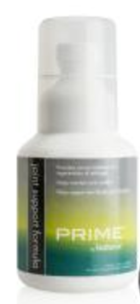
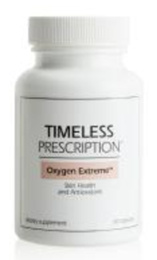
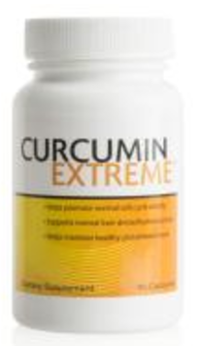
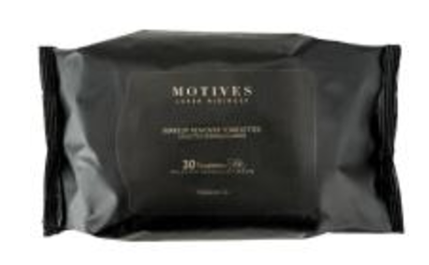
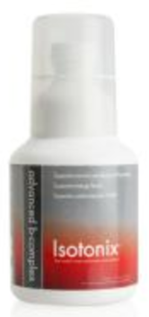
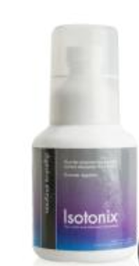
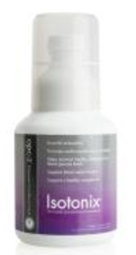
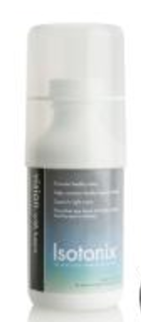
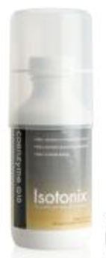
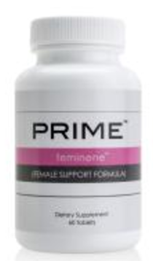
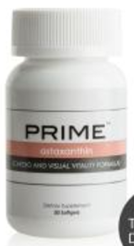
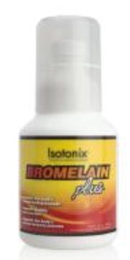
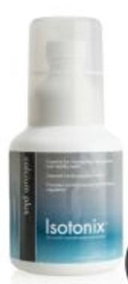
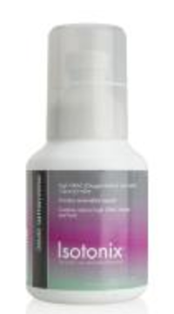
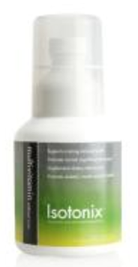
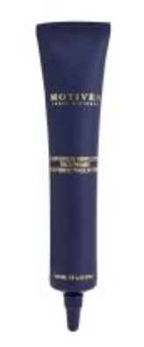
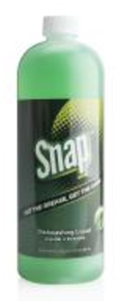
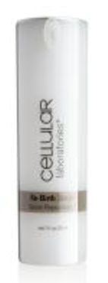
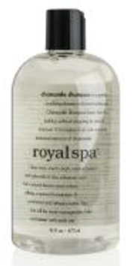
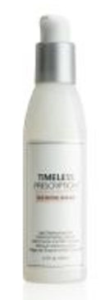
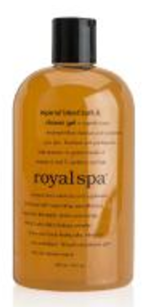
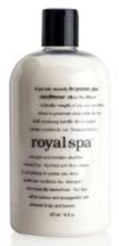
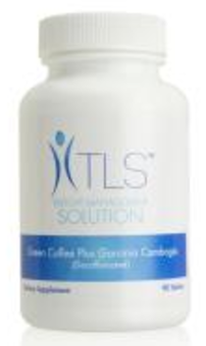
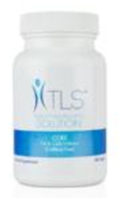
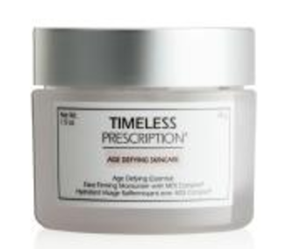
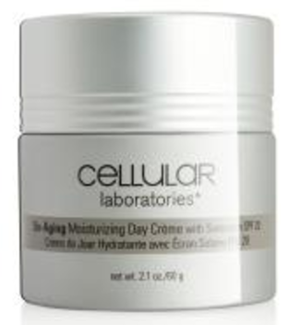
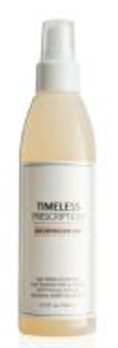
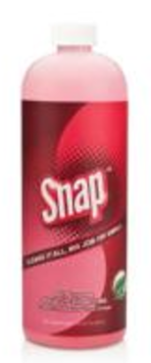
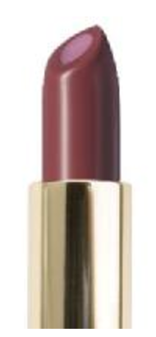
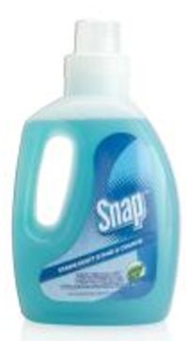
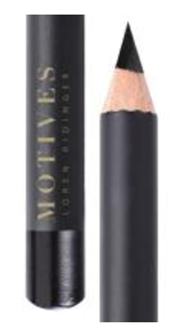
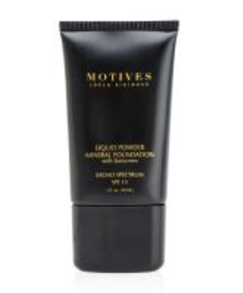
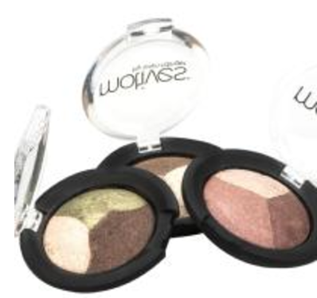
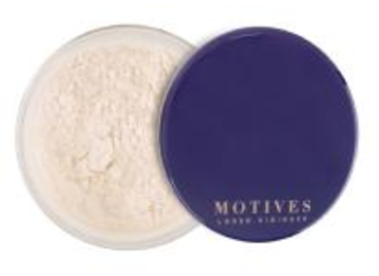
1-month
1-½ month
2-months
3-months
6-months

Slide 2
How I achieve 500 BV per month?
1-months → 330.00 BV x 12 = 3,960 BV
1-½ months → 42.00 BV x 8 = 336 BV
2-months → 376.00 BV x 6 = 2,256 BV
3-months → 71.25 BV x 4 = 285 BV
6-months → 23.50 BV x 2 = 47 BV
6,884 BV / 12 months
= 573.67 BV
How do I share & duplicate to my Team?

Slide 3
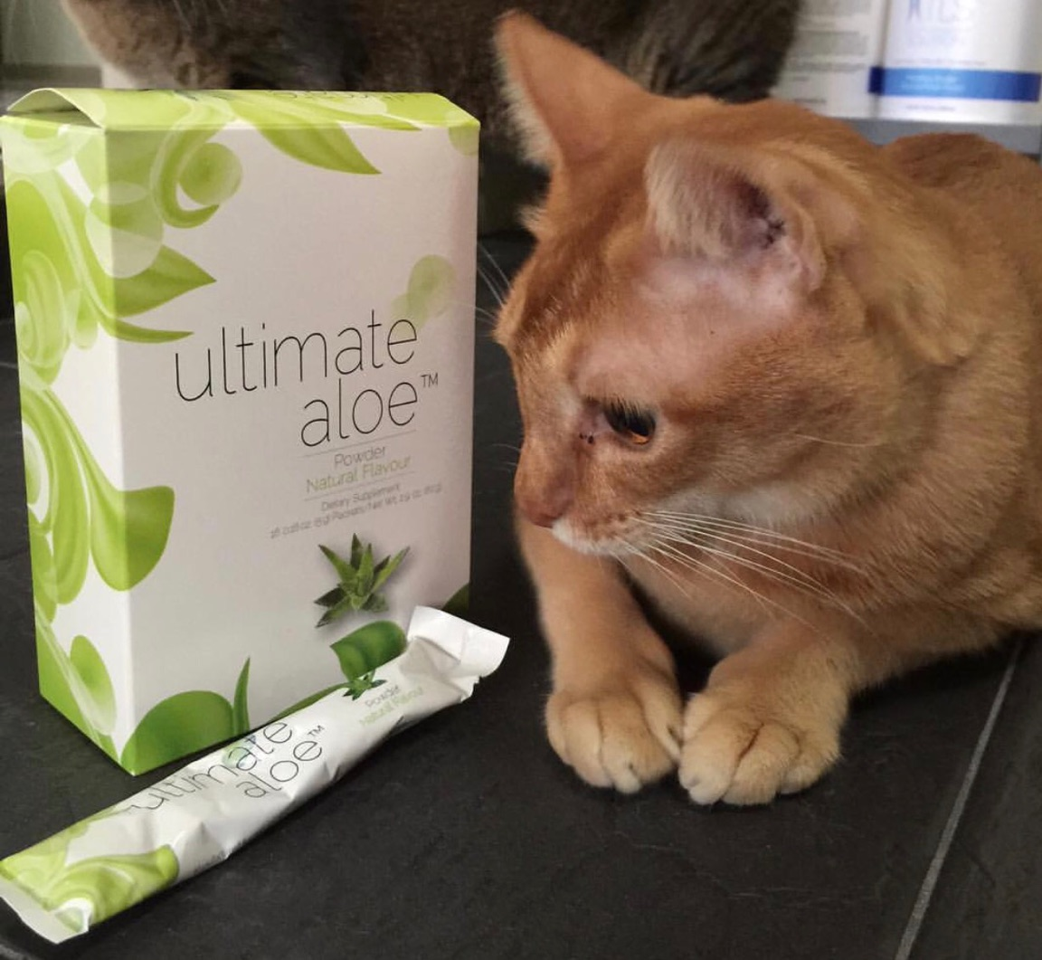
Health & Wellness
Our Shopping Annuity®
OPC Beauty Blend
43.5BV
Digestive Enzymes x 2
36BV
Joint Health Kit + 1 x Curcumin
95 BV
Probiotics x 2
40 BV
1 Aloe Juice
+ 2 Aloe Powder
41 BV
Oxygen Extreme x 2 – 28 BV
Daily Essential Kit+ 1 x OPC-3TM 109.5BV
TLSTM
Personal Care
Skin Care
Home Care
Lumiere Value Kit
– 50 BV
Lumiere Brightening Kit
60 BV
TLSTM Core
32 BV
TLSTM CLA
22 BV
TLSTM Shake
8 BV
Royal Spa Shower Gel, Chamomile Shampoo, Ultra III Shampoo, Tri Protein Plus Conditioner – 25.5 BV
SNAPTM Essential Kit – 20 BV
SNAPTM Triple Enzyme Detergent
– 5.25 BV
SNAPTM All Purpose
– 5 BV
Cellular Lab sun screen – 24 BV
Health & Wellness + TLSTM
455 BV per month
Personal / Skin & Home care
(189.75 BV upon purchase)
Avg. 54.2BV per month
Total BV per month
509.2BV

Slide 4
The Key here is maximum mindset
A Simple comparison
Shop From Your Own Shop
Be A Product Of The Product
Shopping Annuity Is An Income Accelerator
Option A
Minimal Mindset
A team of 20 qualified UFOs
10 on left leg
10 on right leg
80BV Average per UFO per month
Left leg 10 x 80BV
= 800BV per month
Right leg 10 x 80BV
= 800BV per month
Takes at least
6 MONTHS to
Green Flush
Option B
Maximum Mindset
A team of 20 qualified UFOs
10 on left leg
10 on right leg
500BV Average per UFO per month
Left leg 10 x 500BV
= 5000BV per month
Right leg 10 x 500BV
= 5000BV per month
GREEN FLUSH
6 X
in 6 Months
You Have The POWER To Change Your Life & Make More Income Faster with SA
YOU GOT TO WEAR THE JERSEY IF YOU ARE ON THE TEAM , JR

Slide 5
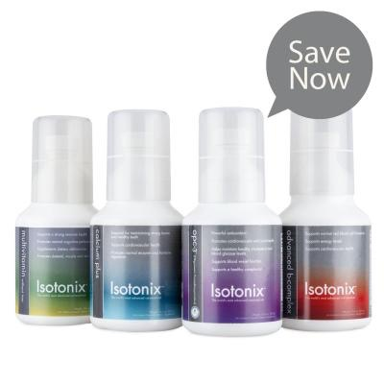
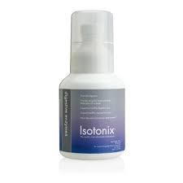
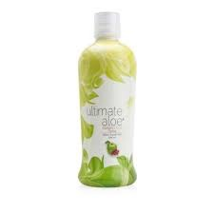
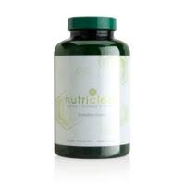
66BV
16BV
16BV
20BV
14BV
30BV
24BV
182 BV
Future Director

Slide 6
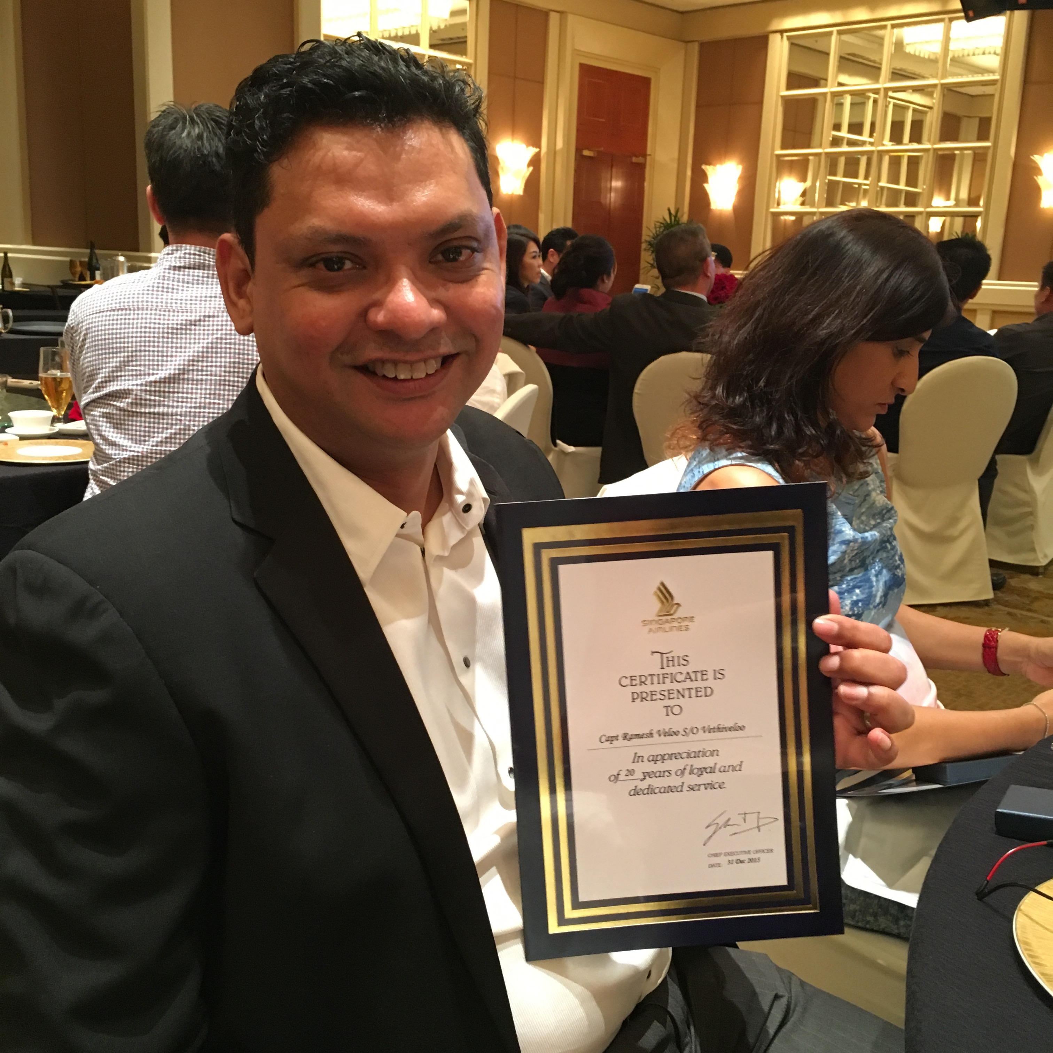
30BV
20BV
42BV
27BV
43.5BV
28BV
23.5BV
17BV
Excellent Customer
231BV

Slide 7
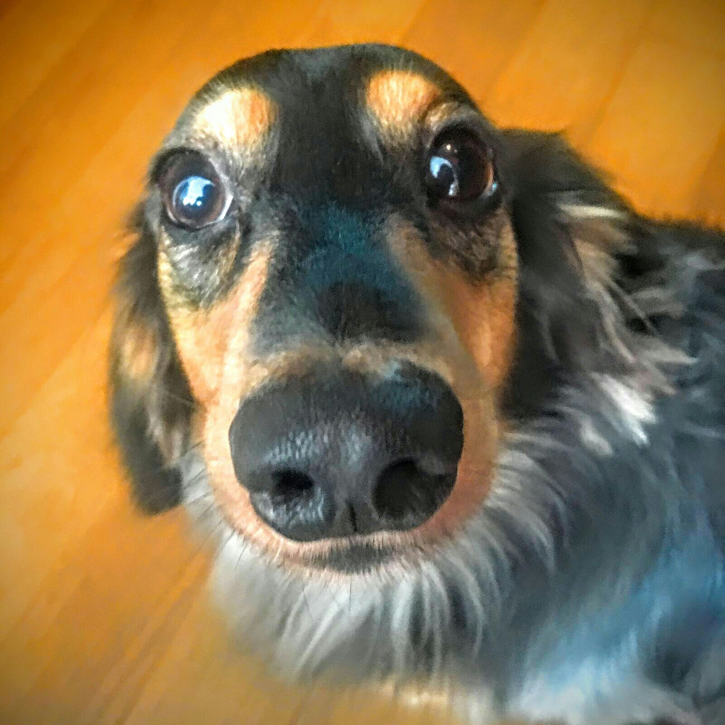
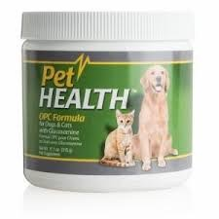
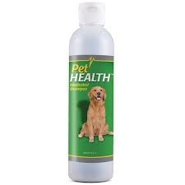
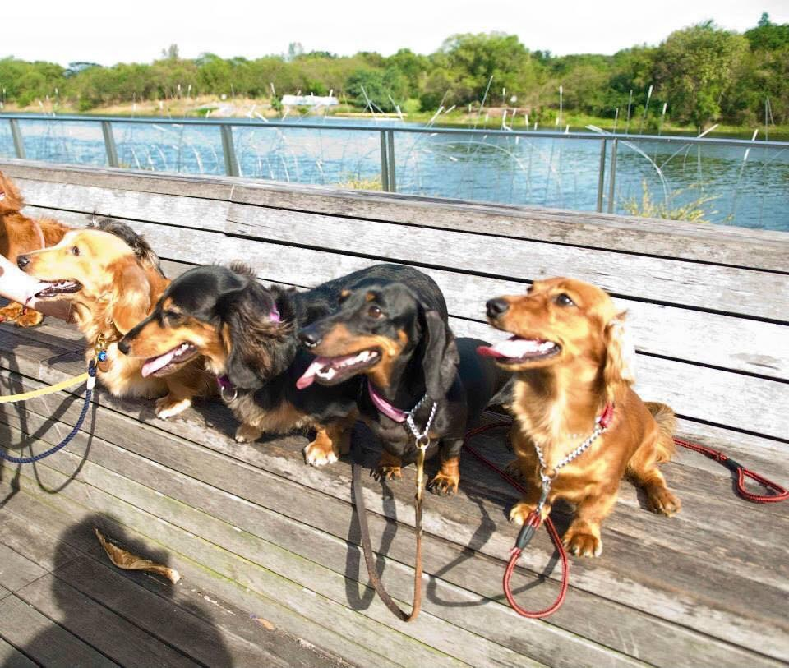
30BV
11.25BV
13.5BV
10BV
Sales Rep.

Slide 9
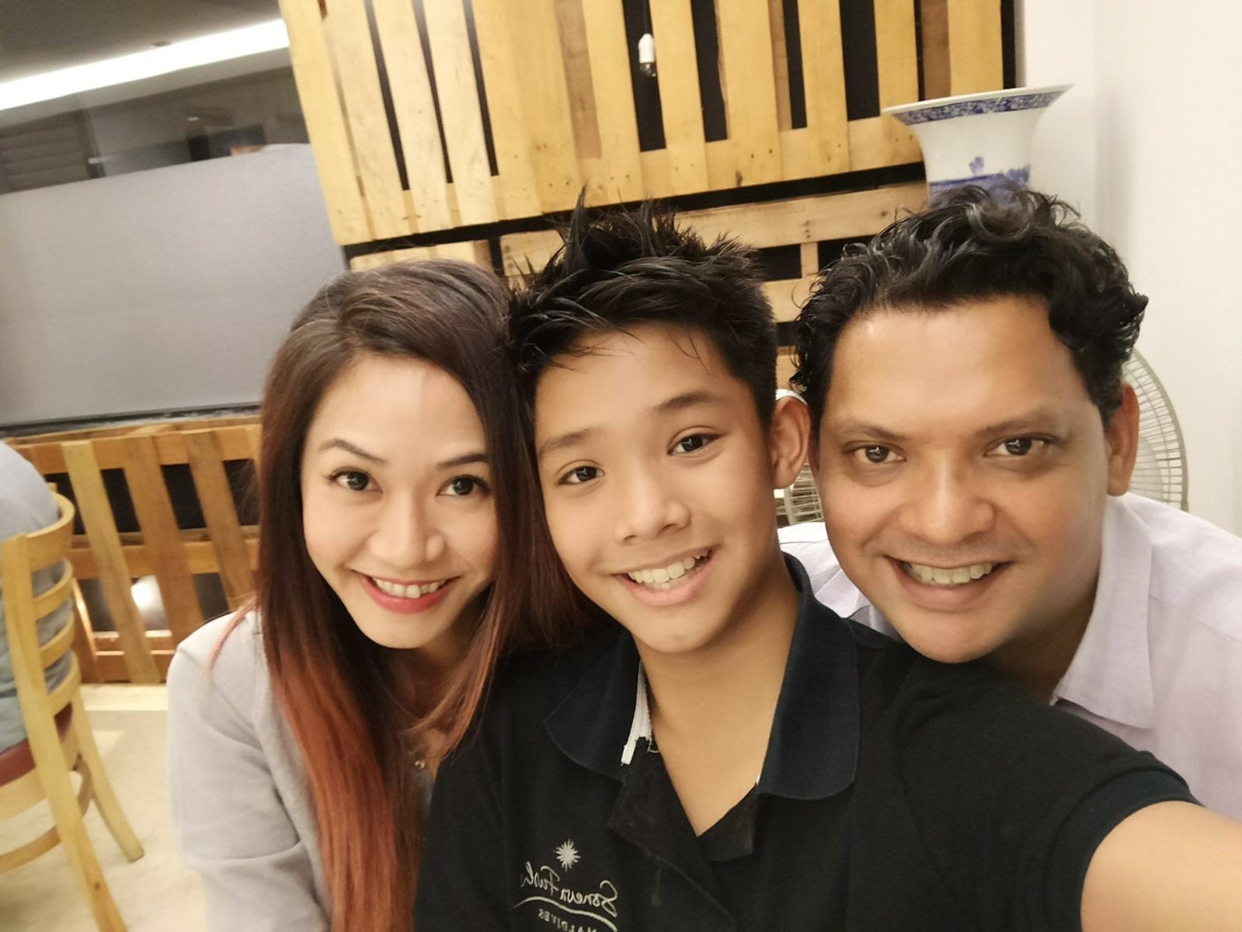
BV
BV
IBV
IBV
IBV
BV
BV
BV
IBV
BV
BV
IBV
IBV
BV
BV
IBV
IBV
BV
BV

